Slide 1
House Rental and Tenancy Application
“Vivir”
Mentor
Dr. Sudeep K S
Presented by -
Yogendra– M150480CA

Slide 2
Problem Definition
House Rental and Tenancy android application
Provides searching, booking and other features to perform associated activities during stay.
Provides features for adding flat and dealing with other activities needed in room renting.

Slide 3
Inputs
Flat details
User details
Text input for searching
User complaints and rent details
Outputs
Notifications to users
Messages of each successful activity
Request to owners
User specific details

Slide 4
Importance and Motivation
To Tenant - Easy,efficient and hassle free searching and booking of flats/rooms
To Owner - Easy,effective and inexpensive way to let their flats and communicate with the tenant.
To Social Aspects - Transparency of rent and price.

Slide 5
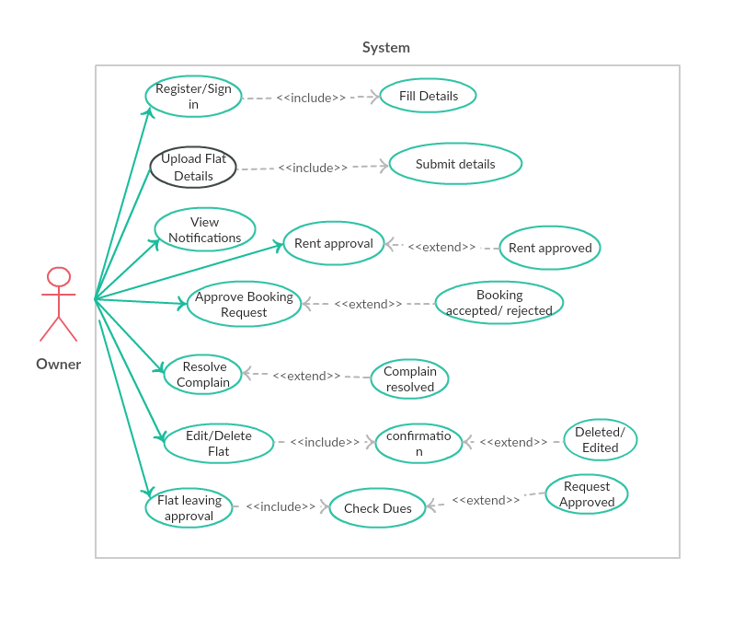
Design Diagrams
Use Case Diagram - Owner

Slide 6
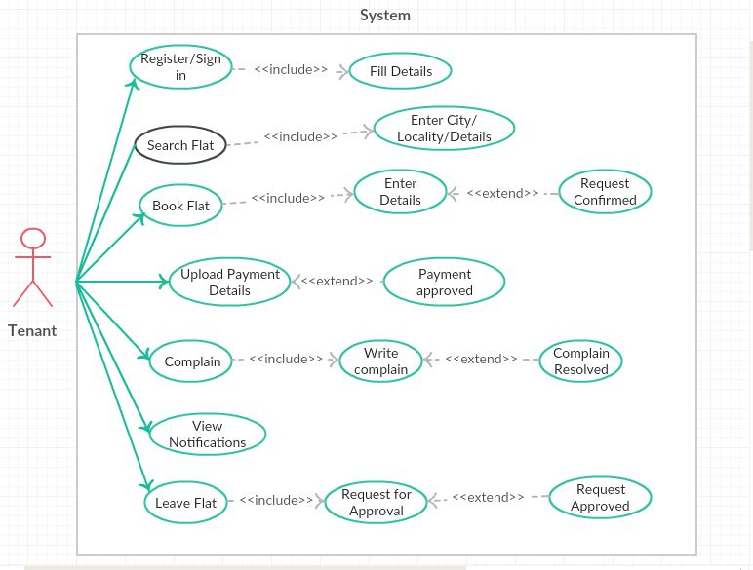
Use Case - Tenant

Slide 7
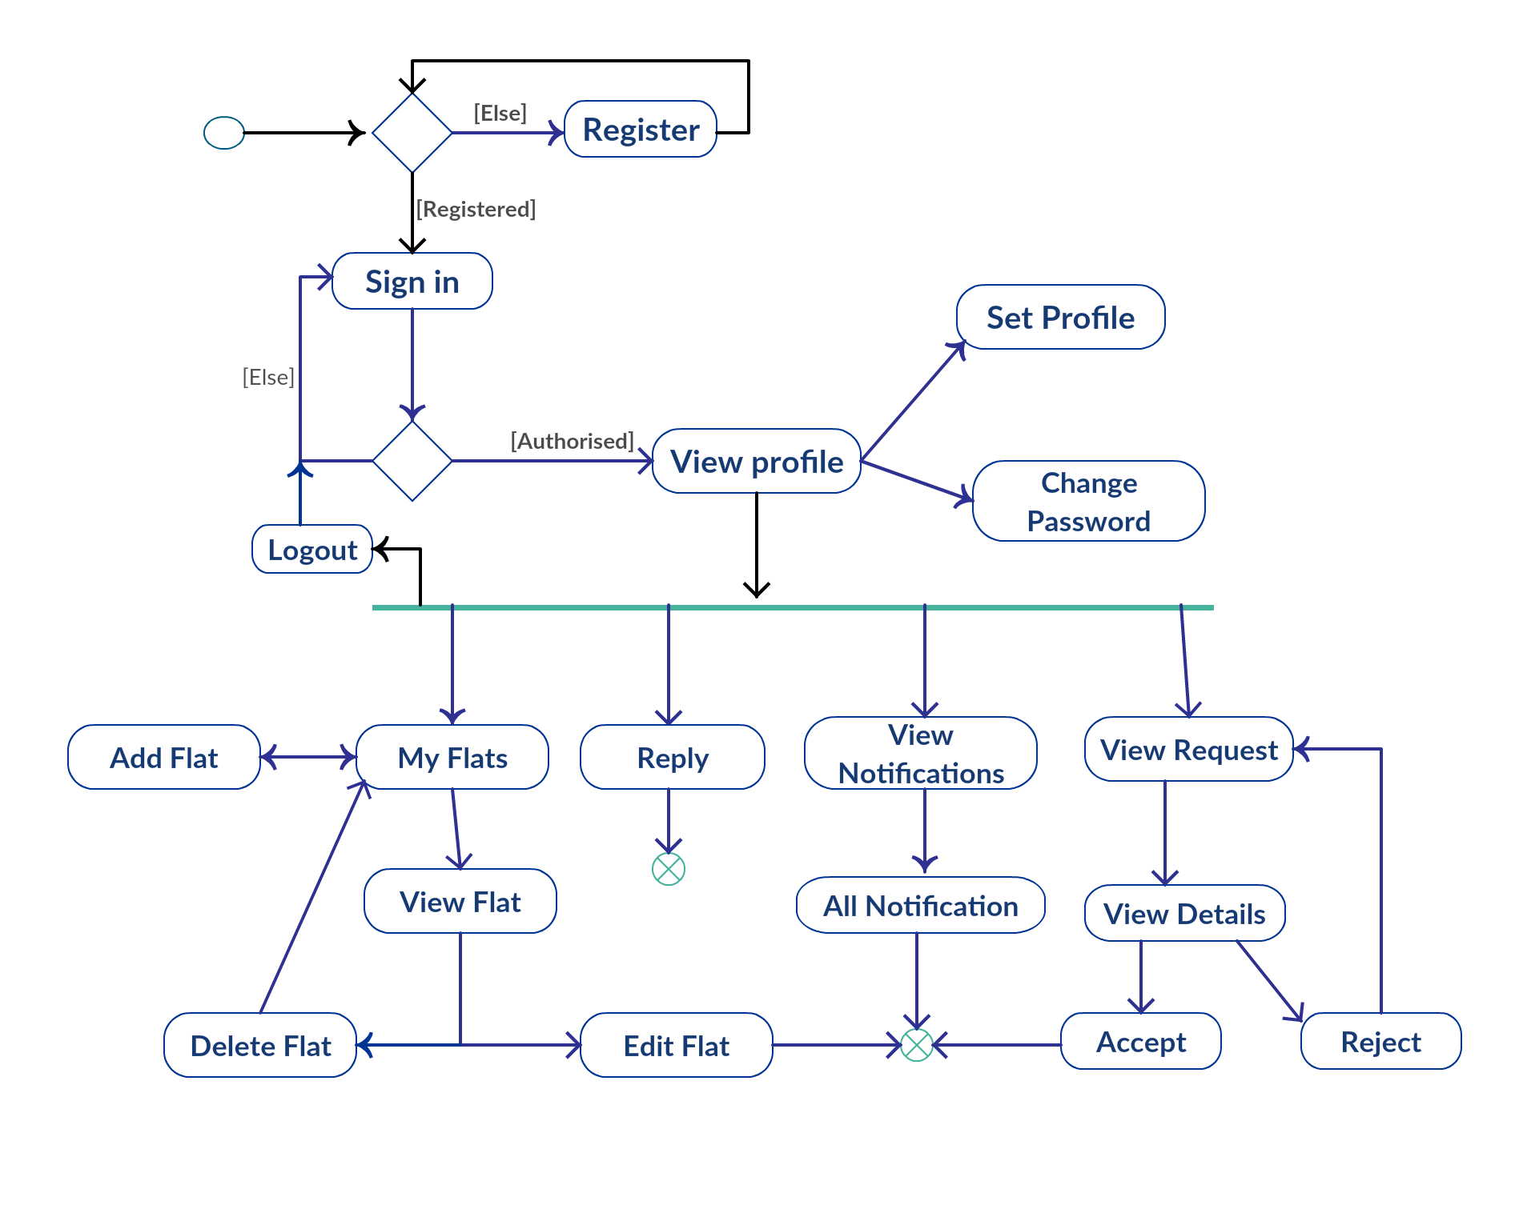
Activity Diagram - Owner

Slide 8
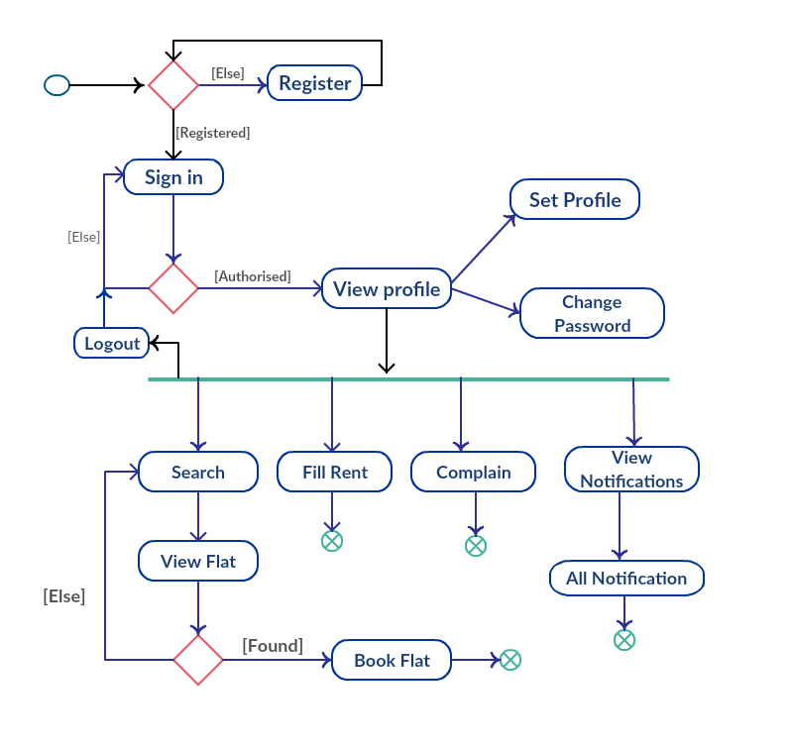
Activity Diagram - Tenant

Slide 9
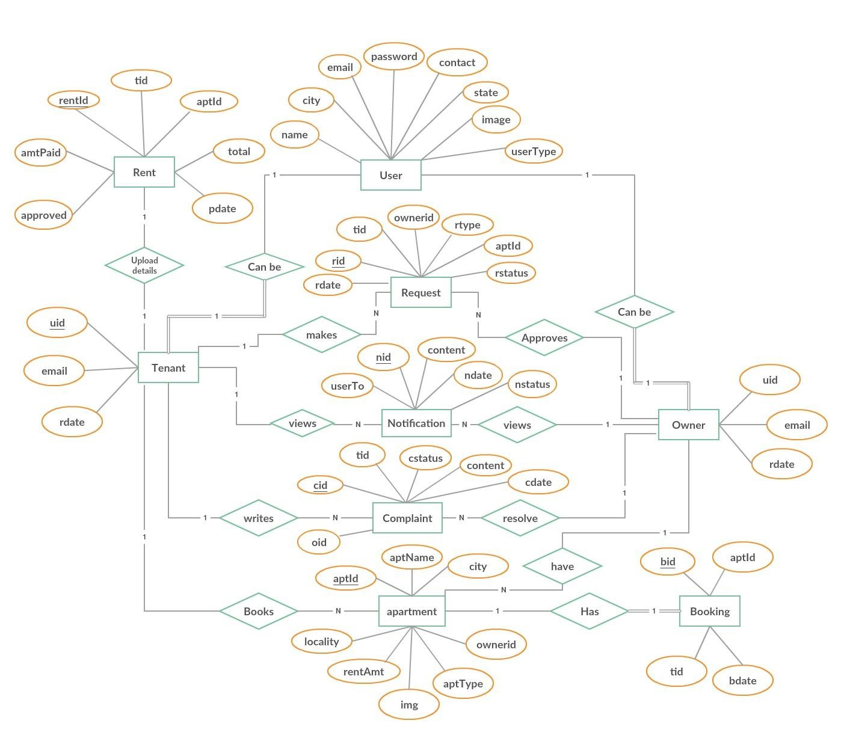
ER - Diagram

Slide 10
Implementation details
Android application using Android studio , Java and XML.
PHP as Server side language and MySQL as Database
Github Link : https://github.com/yogendra-nitc/Vivir
The whole project has been developed considering three major modules - Common Features, Owner Features and tenant Features

Slide 11
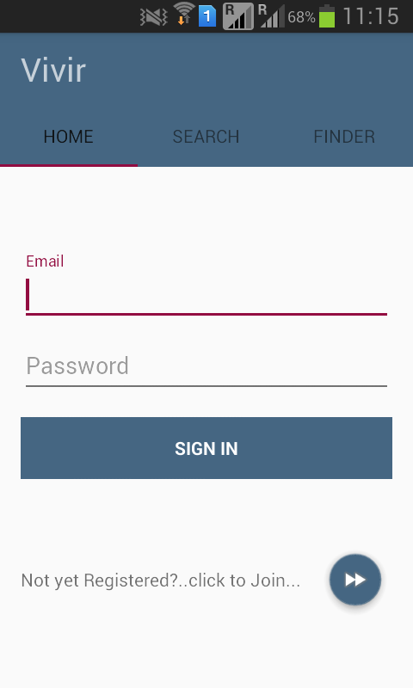
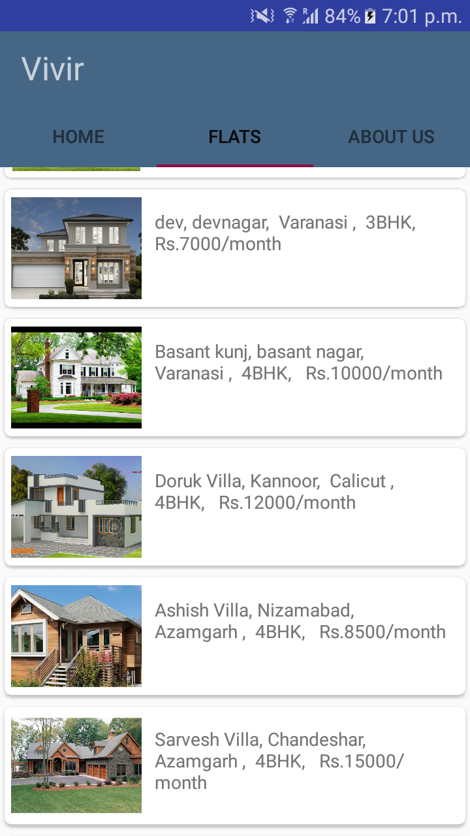
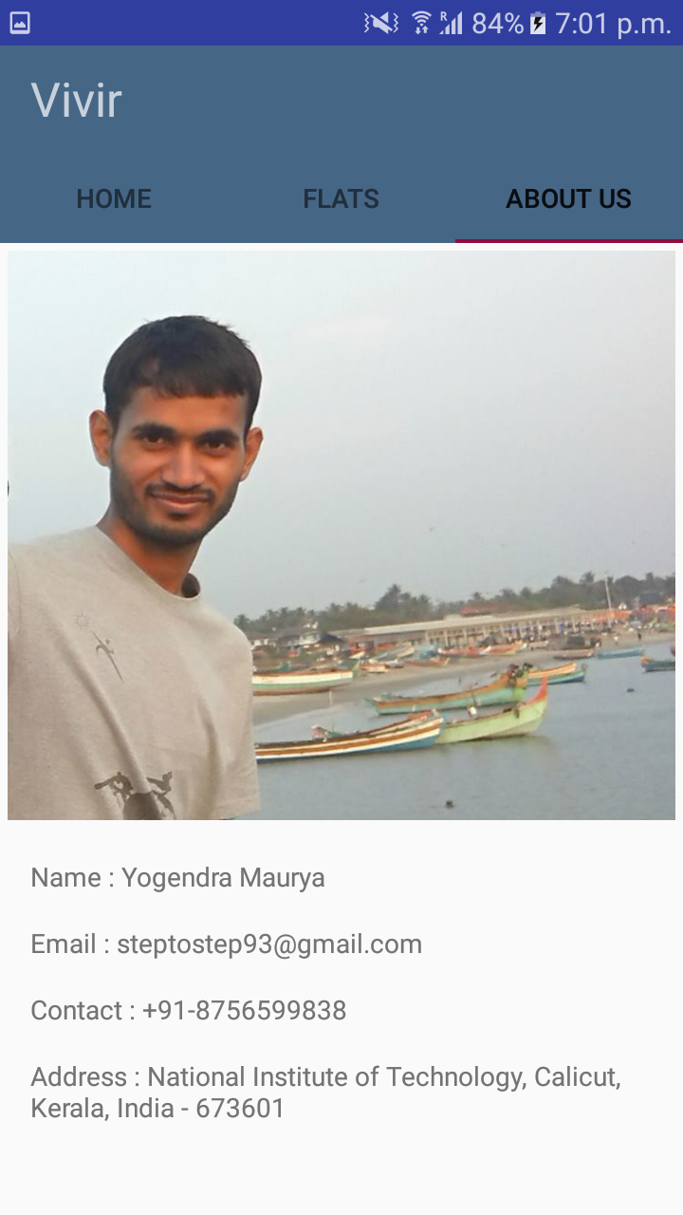
Demo Screenshots

Slide 12
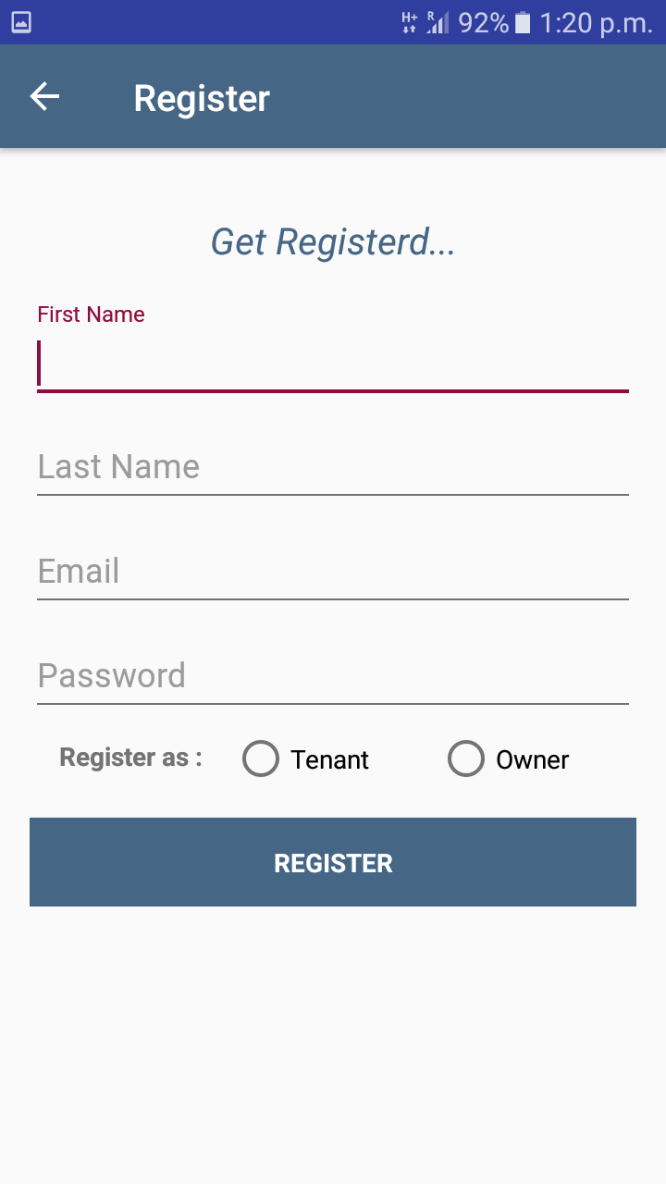
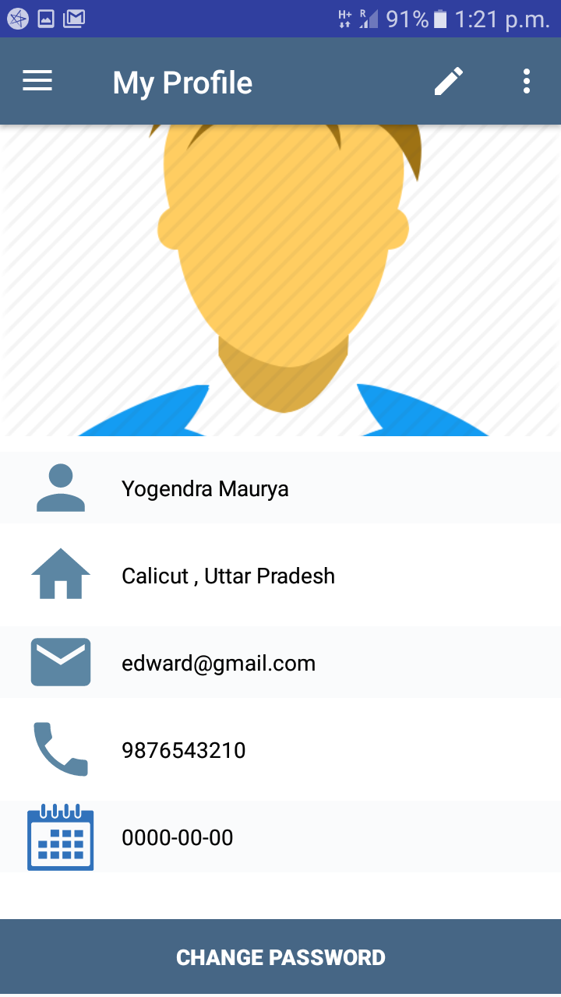
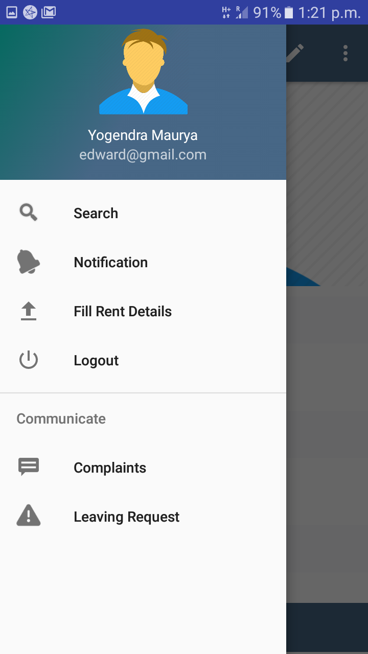

Slide 13
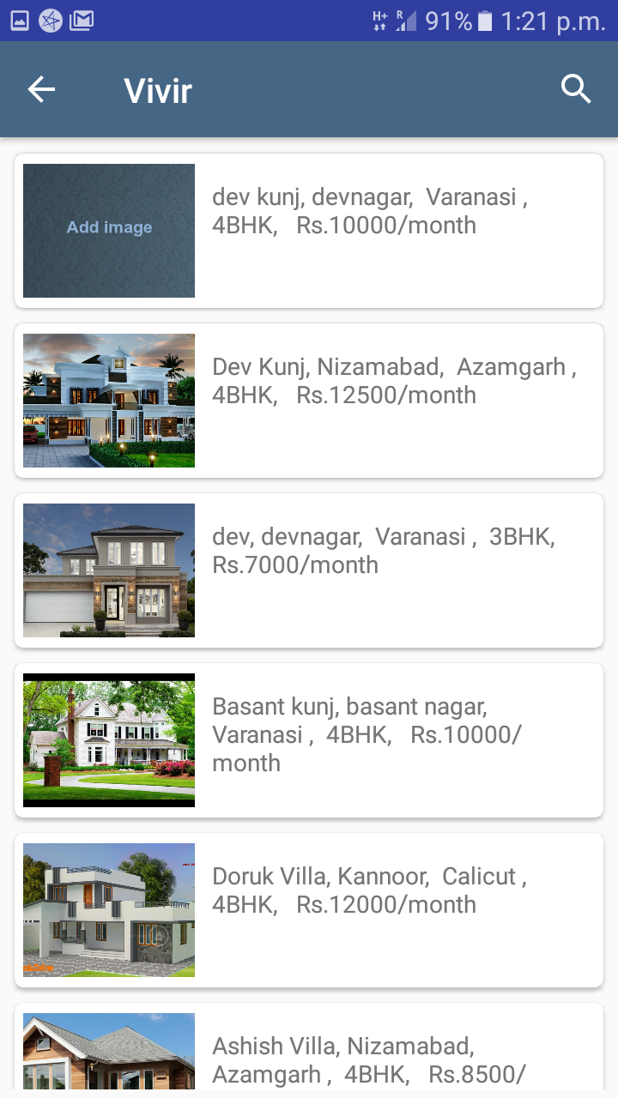
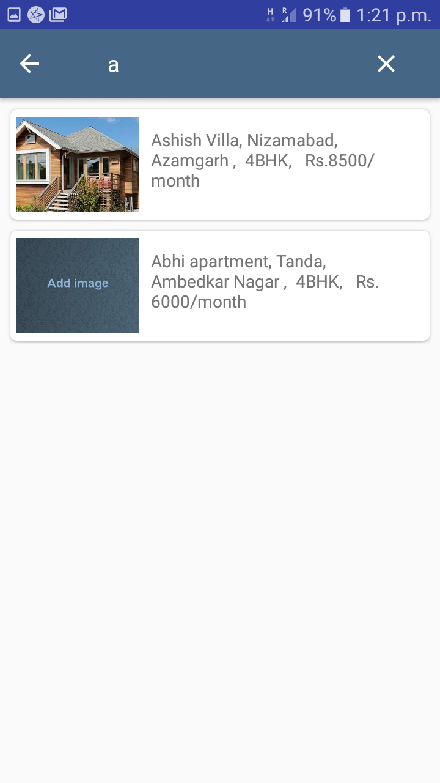
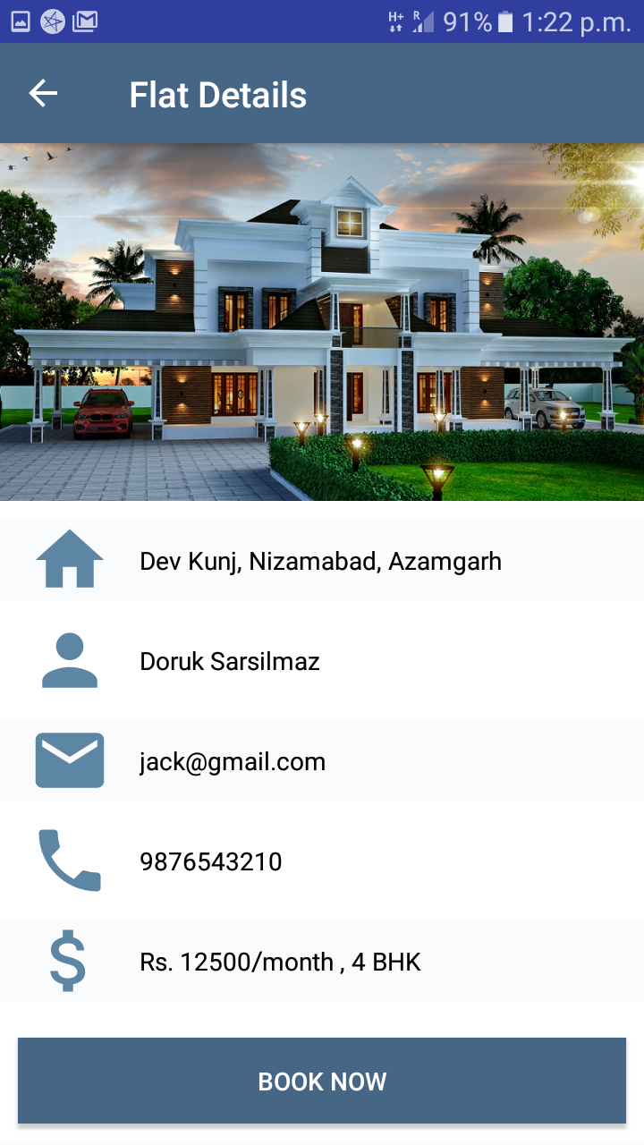

Slide 14
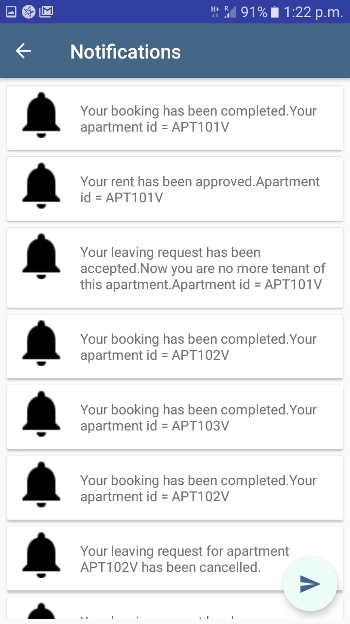
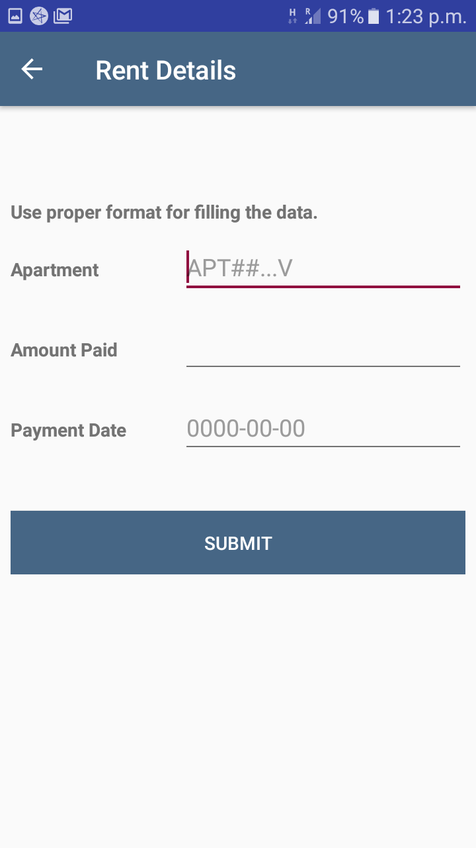
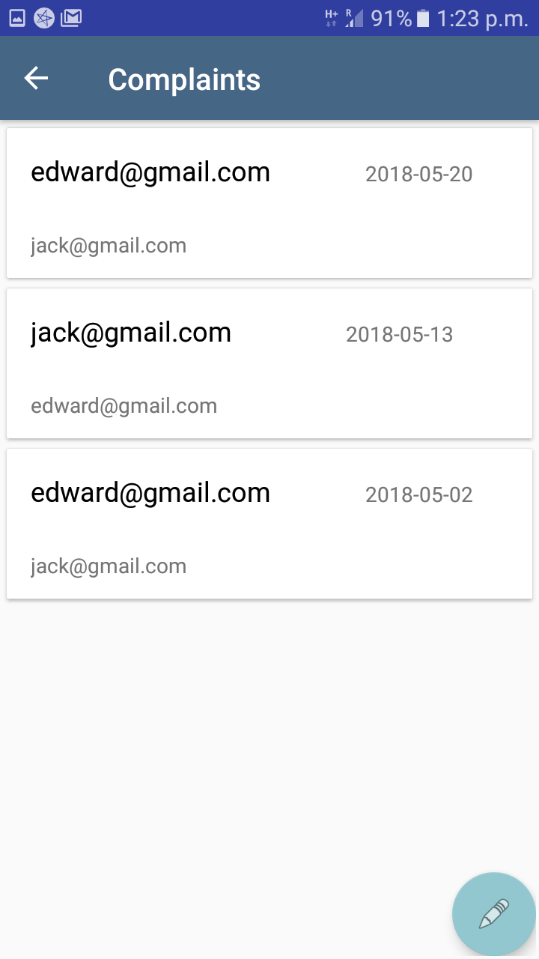

Slide 15
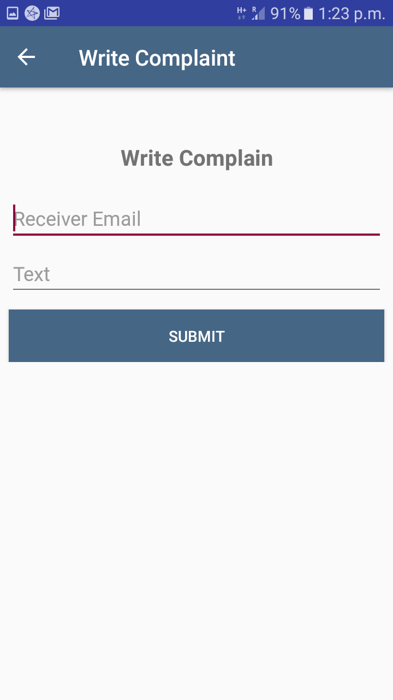
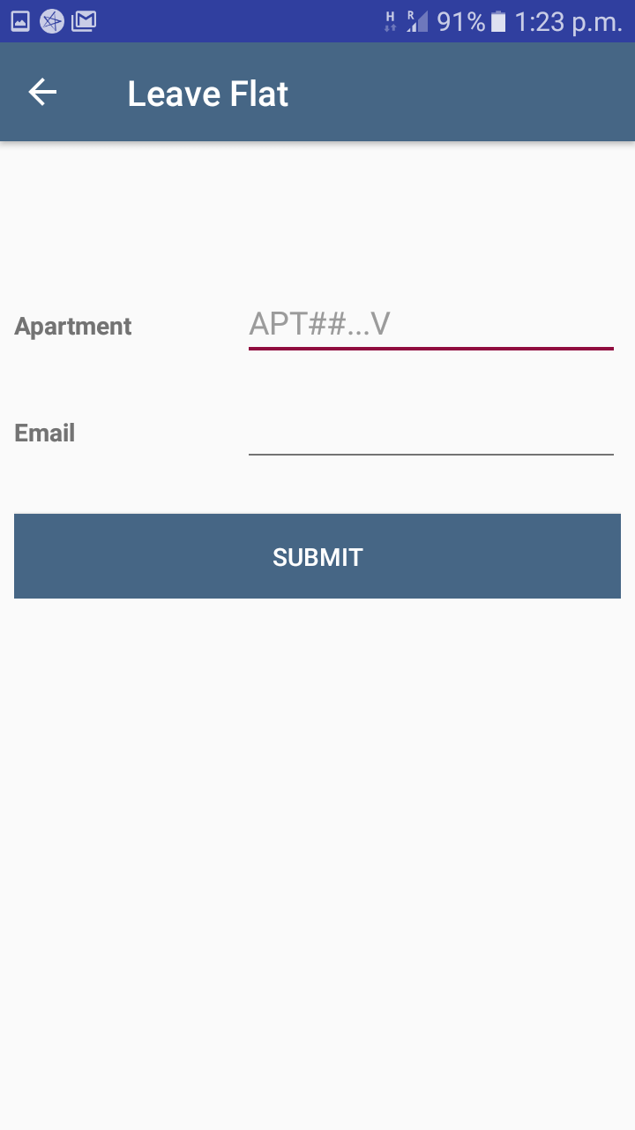
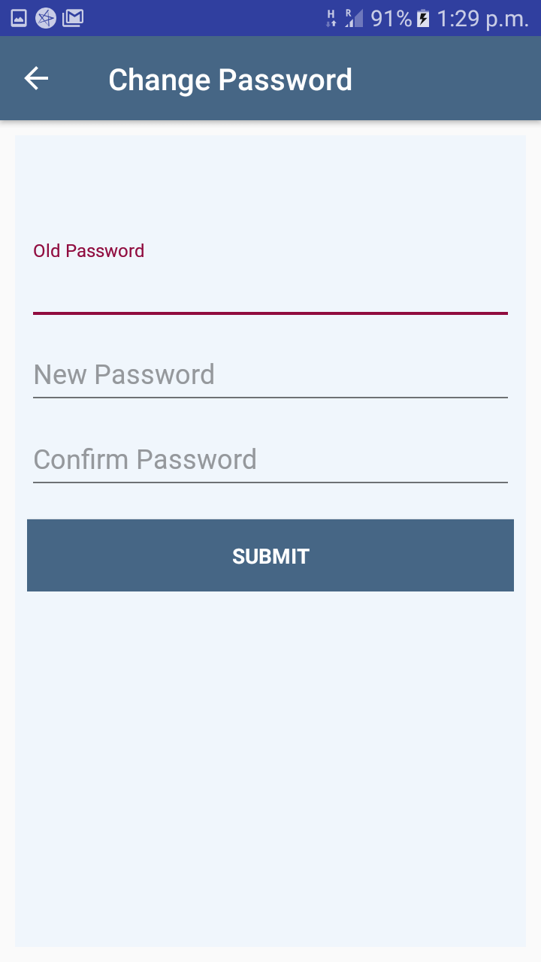

Slide 16
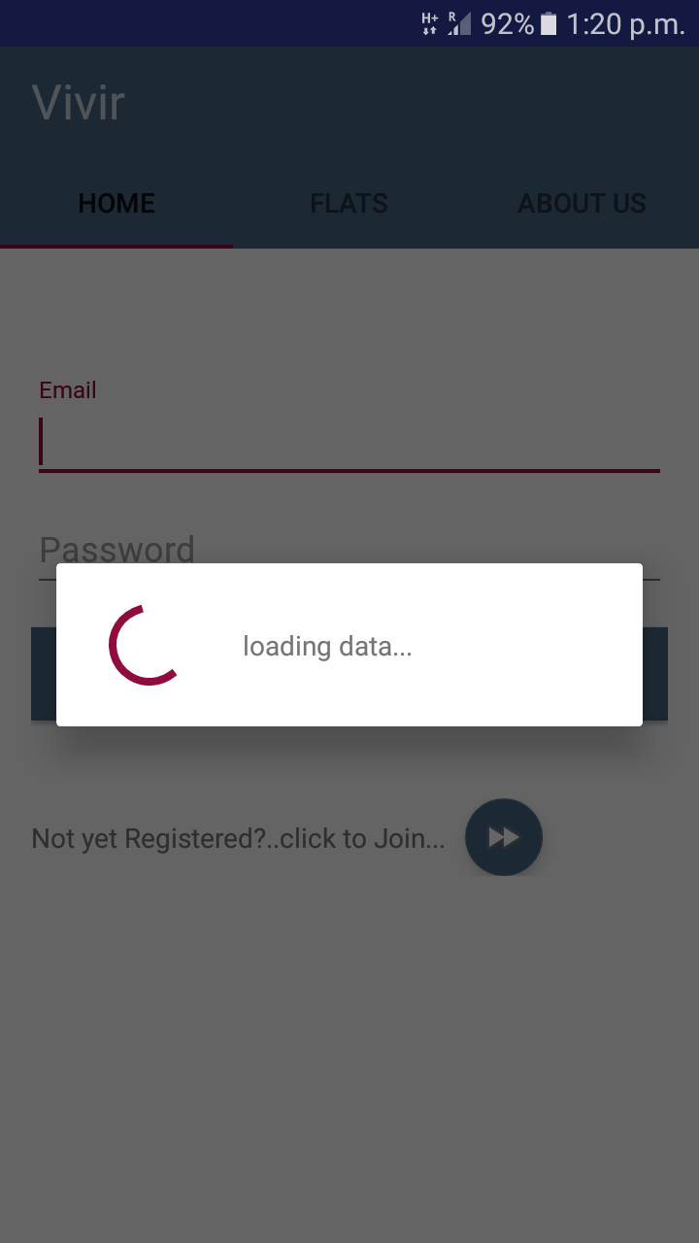

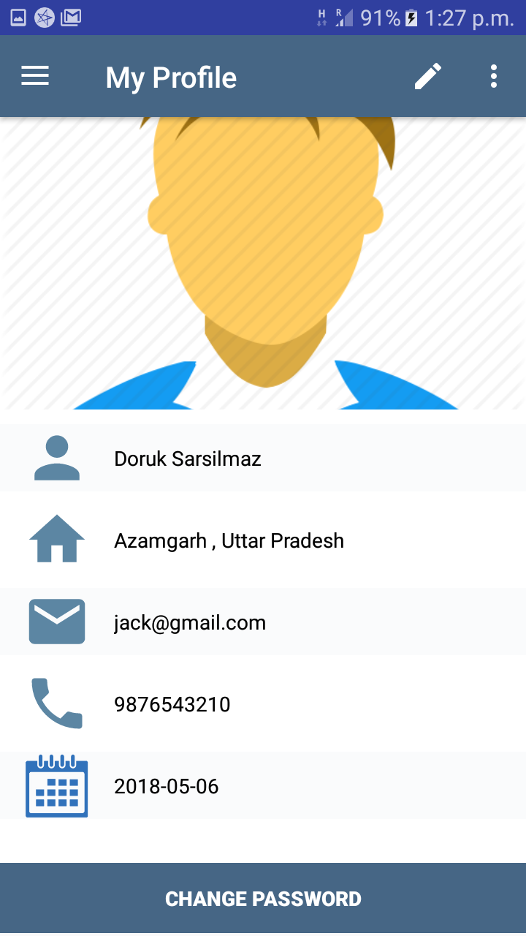

Slide 17
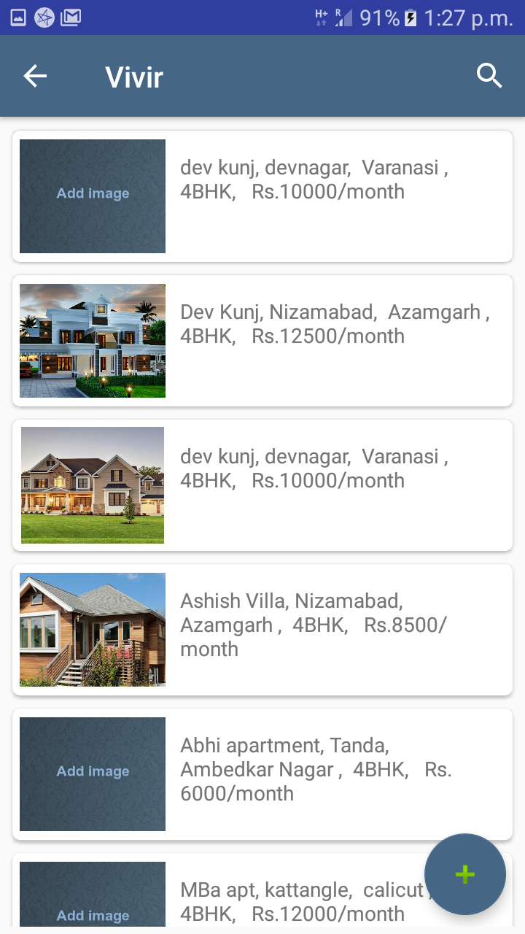
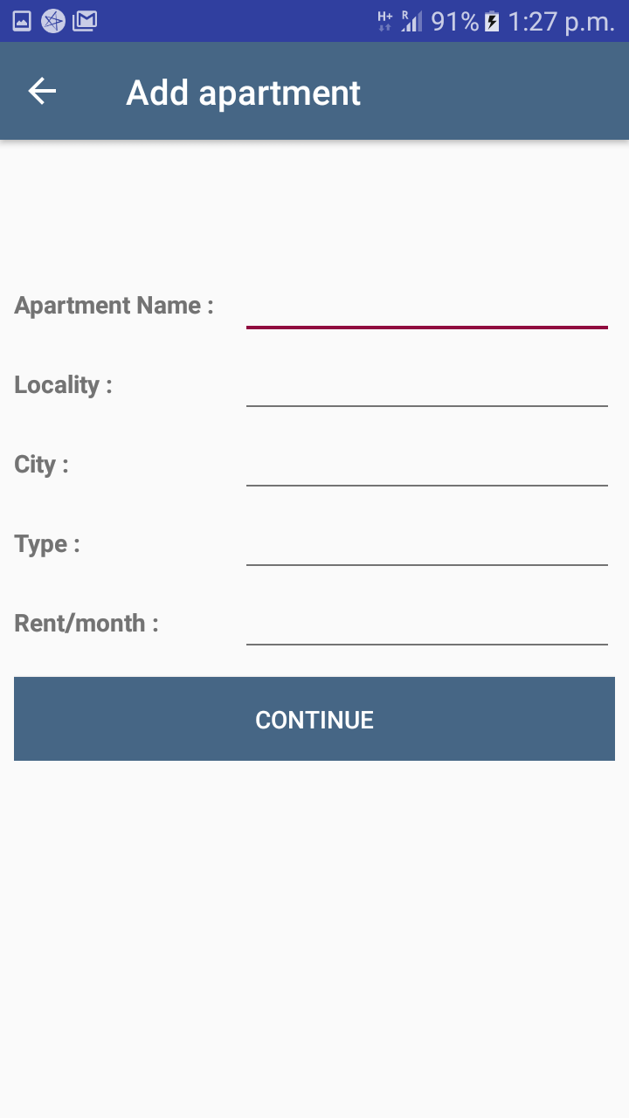
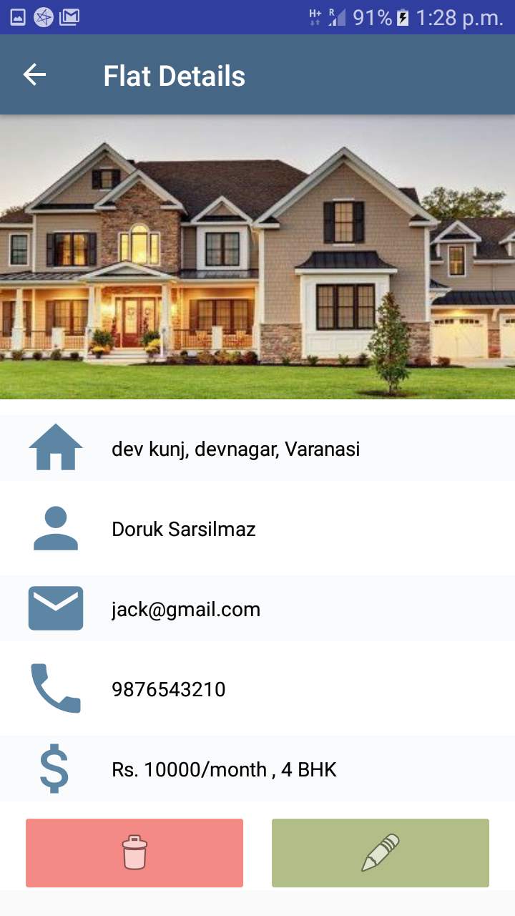

Slide 18
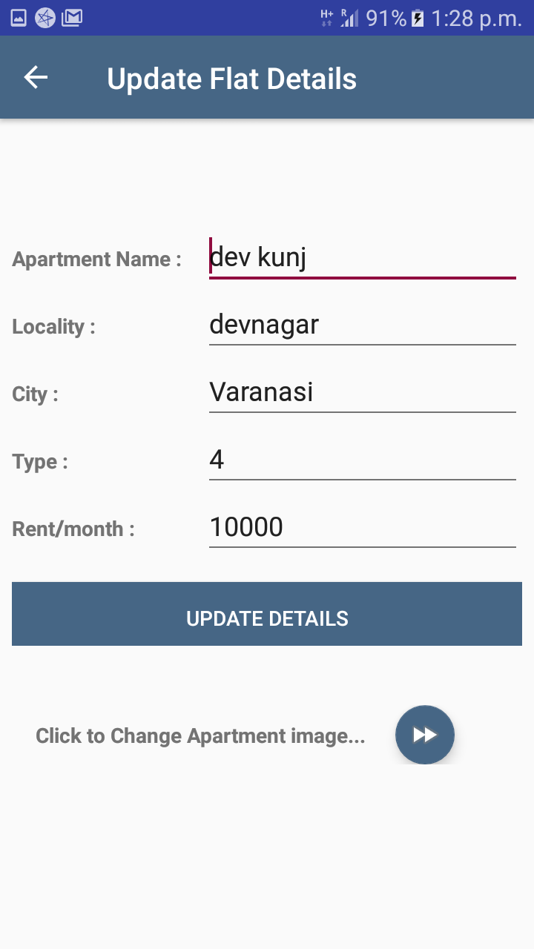
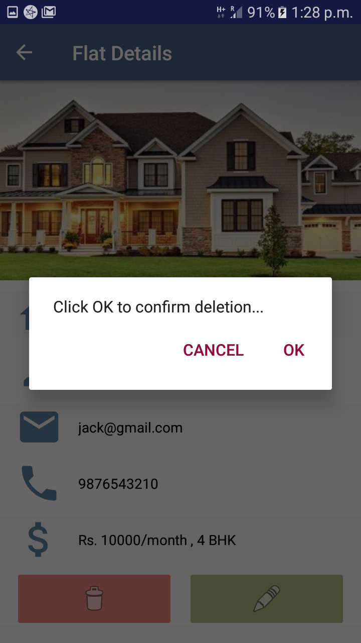
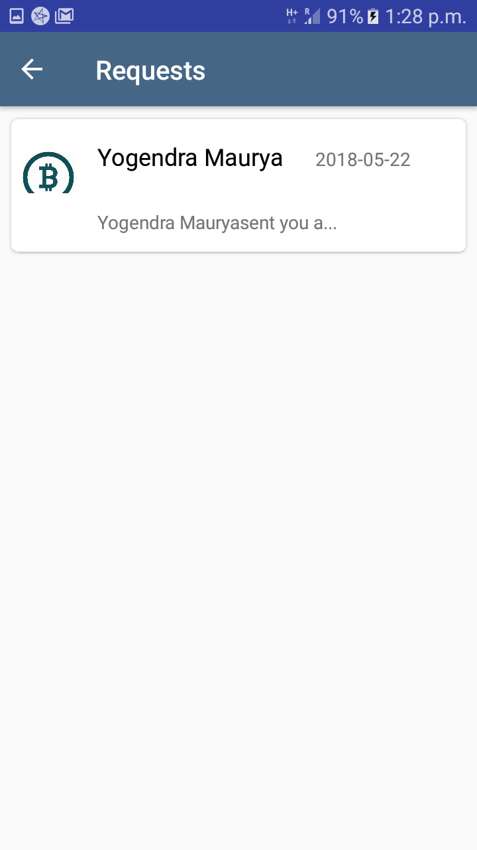

Slide 19
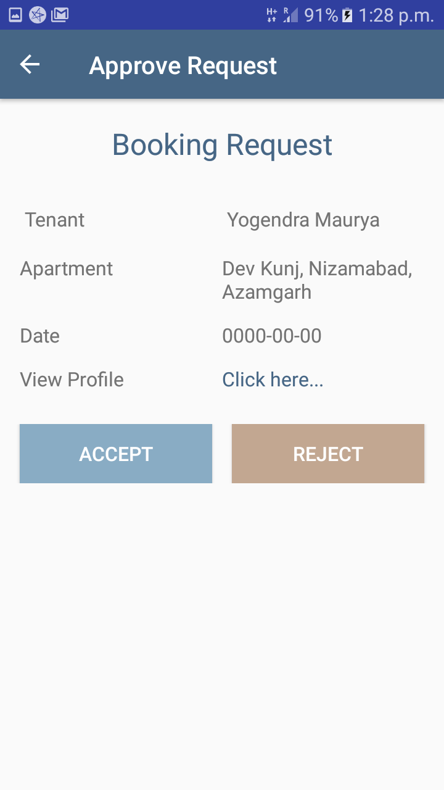
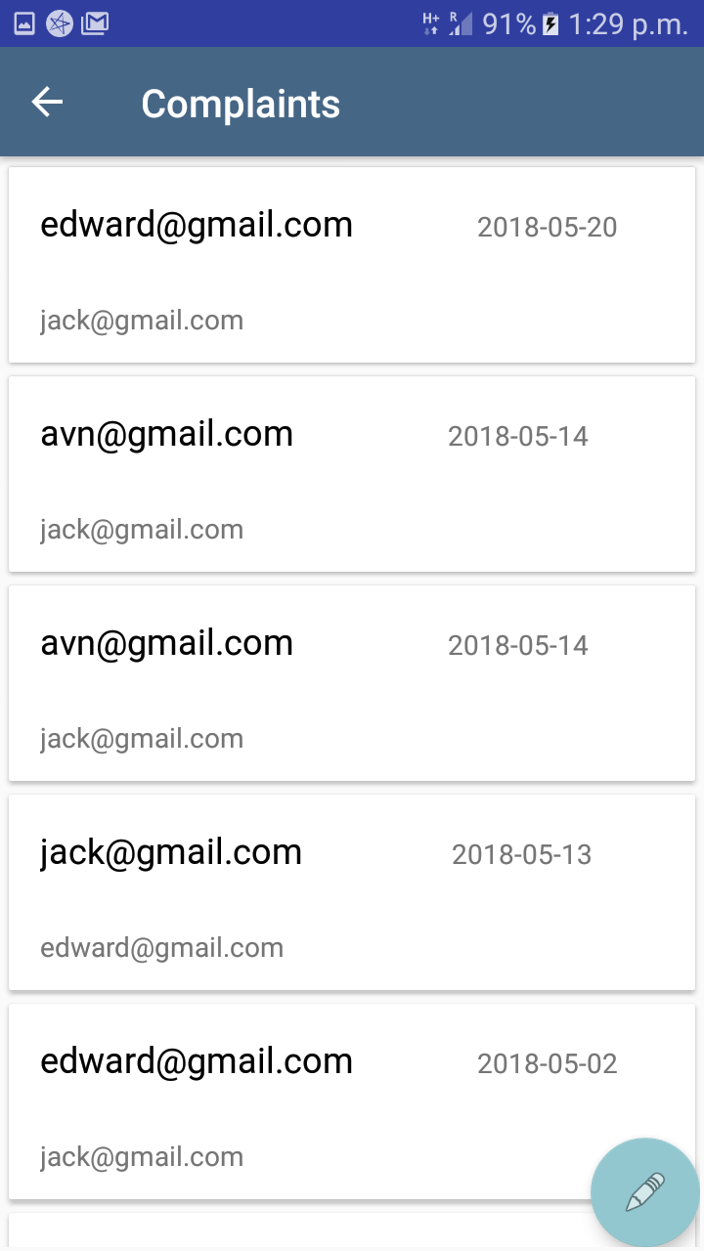
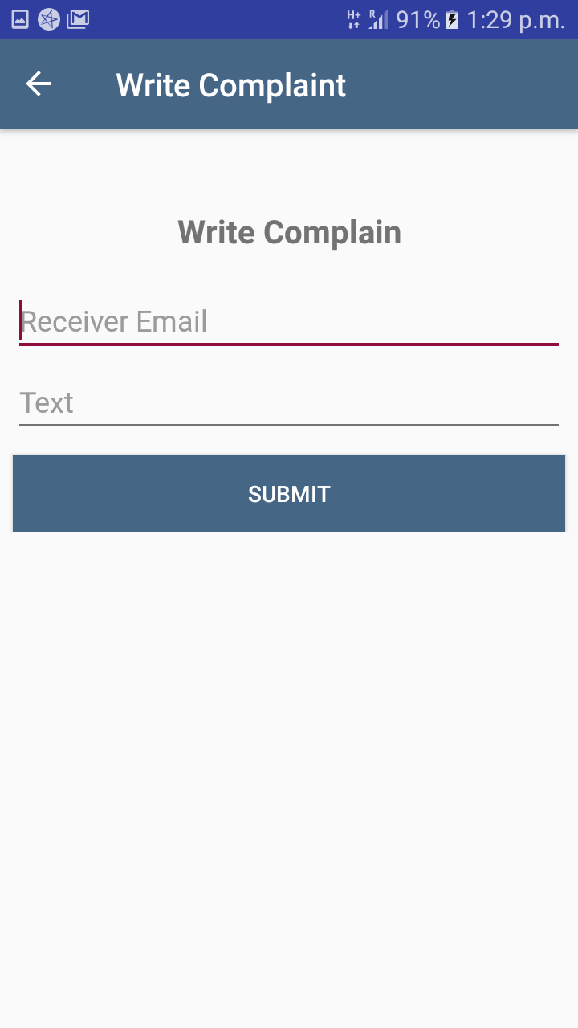

Slide 20

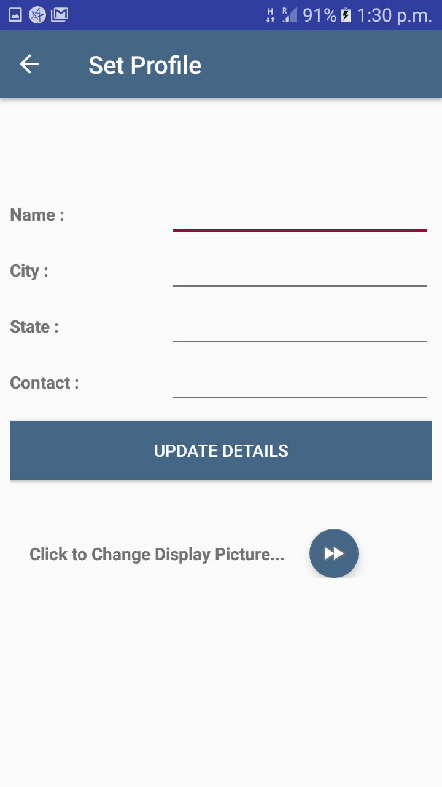
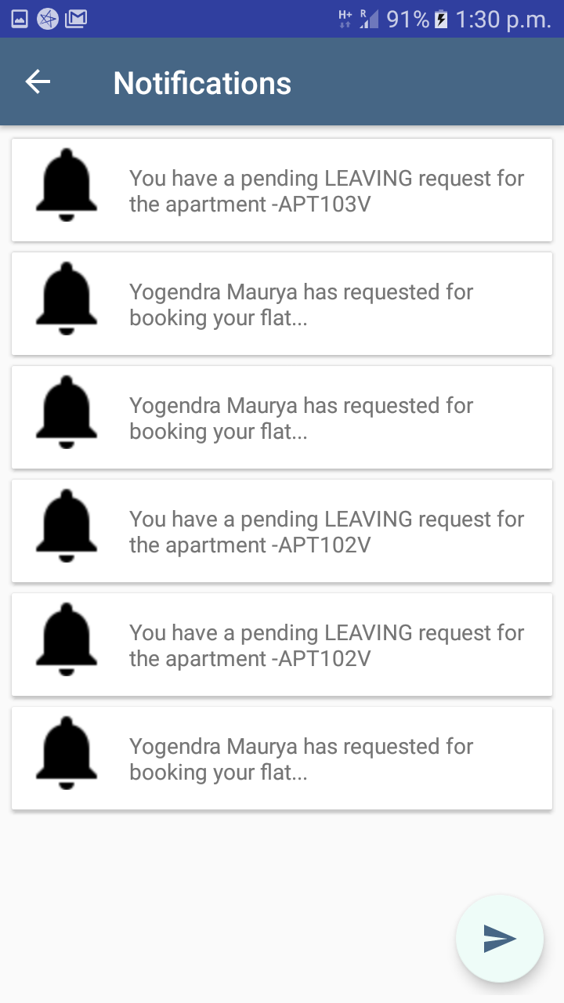

Slide 21
Conclusion
House Rental and Tenancy Application - “ Vivir “ has been devised to make the flat/apartment searching and booking easier and efficient.
It helps to owner to lend their flat easily and deal with the associated activities effectively.
This application will also help in maintaining the transparency of rent and good relationship between owner and tenant.

Slide 22
References
[1] Android Studio: http://developer.android.com/studio/index.html (05/05/2018)
[2] Udacity : https://in.udacity.com/(20/04/2018)
[3] Java - The Complete Reference by Herbert Schildt , 9th Edition
[4] XML - www.tutorialspoint.com
[6] https://www.w3schools.com/php/php_mysql_intro.asp
[7] Ramez Elmasri, Shamkant B. Navathe: FUNDAMENTALS OF Database Systems SIXTH EDITION.

Slide 23
Thank You

